Slide 1
Unit 7: Expert System
Lecture 1

Slide 2
Expert System
An expert system is a computer system whose performance is guided by specific, expert knowledge in solving problems.
It is a computer system that simulates the decision- making process of a human expert in a specific domain. Expert system is one of the early (large- scale) successes of artificial intelligence.
An expert system is an “intelligent” program that solves problems in a narrow problem area by using high-quality, specific knowledge rather than an algorithm.
Expert systems are used by most of the large or medium sized organization as a major tool for improving productivity and quality.
An expert system’s knowledge is obtained from expert sources and code in a form suitable for the system to use in its process.

Slide 3
For example, there are expert systems that can diagnose human illnesses, make financial forecasts, and schedule routes for delivery vehicles. The expert system is a branch of AI designed to work within a particular domain.
As an expert is a person who can solve a problem with the domain knowledge in hands it should be able to solve at the level of a human expert.
The source of knowledge may come from a human expert and /or from books.
As knowledge plays a key role in the functioning of expert systems they are also known as knowledge-based systems and knowledge based expert systems.
The expert’s knowledge about solving the given specific problem is called knowledge domain of the expert.

Slide 4
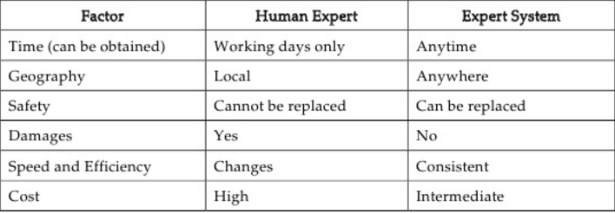
Table: Comparision between expert system and human expert

Slide 5
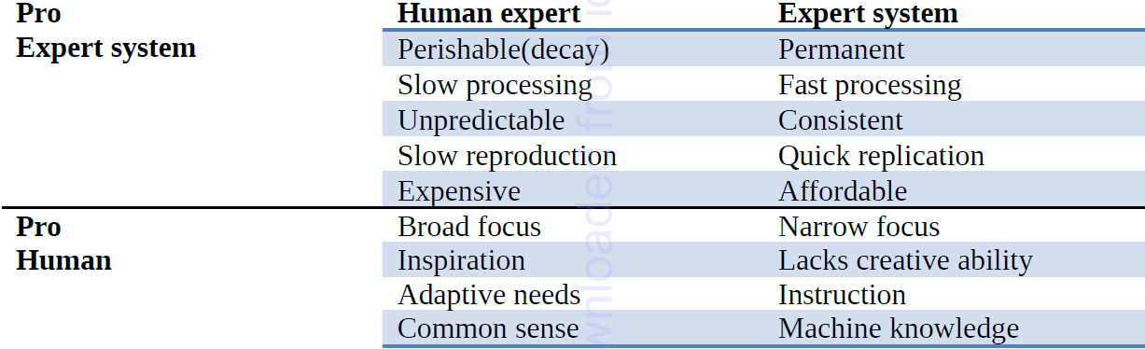
Advantages/Disadvantages (Comparison between human expert and Expert system)

Slide 6
Components of ES
For a workable expert system more than a set of rules is required. We need four structures:
Knowledge Base - a data structure which contains the rules, often in IF THEN rules
Working Memory - a data structure which stores information about a specific problem.
Inference Engine - a set of procedures for matching knowledge base with problem specific data in working memory.
User Interface - Controls the dialog between user and the system.

Slide 7
The Architecture of Expert Systems
The process of building expert systems is often called knowledge engineering.
The knowledge engineer is involved with all components of an expert system:
Building expert systems is generally an iterative process.
The components and their interaction will be refined over the course of numerous meetings of the knowledge engineer with the experts and users

Slide 8
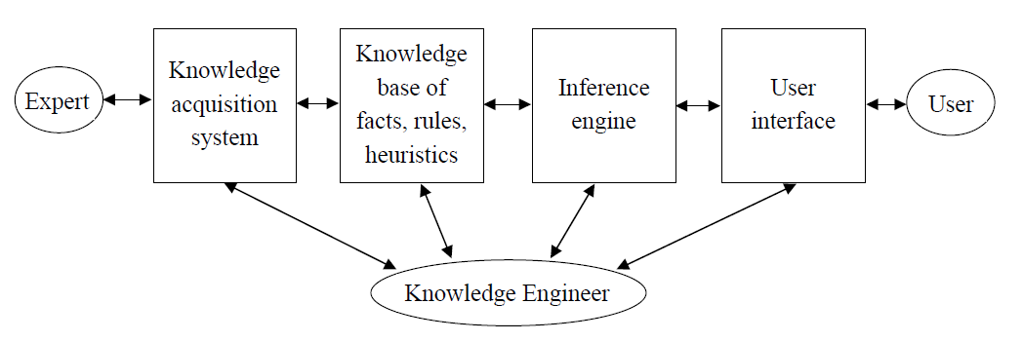
Figure: Architecture of Expert System

Slide 9
Knowledge Representation in Expert System
1. Logic (Propositional and Predicate Logic) Based Representation
Logic-based representations involve using formal logic (such as propositional or predicate logic) to describe knowledge. Facts and relationships are encoded as logical statements.
Example: A propositional logic statement could be "P → Q" (If P is true, then Q must also be true).

Slide 10
2. Rule Based System:
A rule is an IF-THEN type statement
if<certain conditions are true> then <take certain actions>
Knowledge Base: Knowledge Engineering is the process of filling in an expert system knowledge base.
Knowledge is information that has been:
Interpreted, categorized, applied, experienced and revised

Slide 11
3. Semantic Networks
A semantic network is a graph structure where nodes represent concepts, and edges represent relationships between those concepts.
Example: A node could represent the concept "Bird," and an edge could represent the relationship "is a type of" to connect "Bird" with "Animal."
Usage: Useful for representing hierarchical relationships, inheritance, and properties of objects.

Slide 12
4. Ontology Based
Definition: Ontologies are more advanced frameworks that define a formal specification of a set of concepts and their relationships within a domain. They provide a shared vocabulary for representing knowledge.
Example: In a medical expert system, an ontology could describe various diseases, symptoms, treatments, and their interrelationships.
Usage: Ontologies are especially useful for representing knowledge in complex domains, enabling reasoning, data integration, and interoperability.

Slide 13
5. Frames Based:
Definition: A frame is a data structure that holds information about a concept in a predefined format, similar to a record or object in object-oriented programming.
Example: A frame for "Car" might have slots for attributes like "make," "model," "color," "engine type," and "owner."
Usage: Frames are well-suited for representing complex objects with various properties and can include default values, constraints, and rules for behavior.

Slide 14
Inference Mechanisms:
Inference mechanisms are a crucial part of expert systems, enabling them to draw conclusions or make decisions based on the knowledge that has been represented in the system.
These mechanisms process the knowledge base, apply rules, and make inferences to provide the system's output. There are primarily two types of inference
Forward Chaining
Backward Chaining

Slide 15
Forward Chaining
Forward chaining is a data-driven approach, meaning that it starts with known facts (the data) and applies inference rules to derive new facts.
The system works by moving forward from the known facts to the conclusion.
How Forward Chaining Works:
Start with known facts: The system begins with the facts that are provided or already known.
Apply rules: It evaluates the inference rules (usually of the form "IF condition THEN action"). If the conditions of a rule are satisfied by the known facts, the system applies the rule and derives new facts.

Slide 16
Repeat: The new facts generated may be used in subsequent rule applications.
Stop: The process continues until the system reaches a conclusion or no further rules can be applied.
Example of Forward Chaining:
Imagine a simple expert system designed to diagnose a patient’s illness based on symptoms.

Slide 17
Knowledge Base:
Rule 1: IF the patient has a cough AND a fever, THEN the patient might have the flu.
Rule 2: IF the patient has a cough AND a sore throat, THEN the patient might have a cold.
Rule 3: IF the patient has a fever AND a headache, THEN the patient might have a migraine.
Known Facts:
The patient has a cough.
The patient has a fever.

Slide 18
2. Backward Chaining
Backward chaining is a goal-driven approach, meaning it starts with a hypothesis (a goal) and works backward to determine whether the known facts support that hypothesis.
It starts with a goal or conclusion and tries to prove it by tracing back through the rules to the data that supports it.

Slide 19
How Backward Chaining Works:
Start with a goal: The system begins by specifying a goal or conclusion that needs to be verified.
Search for rules: The system checks if there are any rules whose conclusion matches the goal.
Check rule conditions: If a matching rule is found, it examines the conditions (antecedents) of the rule to see if they are satisfied by known facts or if they themselves need further investigation.
Repeat: The system recursively searches for rules to support the conditions of the rules until either the goal is verified or no supporting facts can be found.
Stop: The process concludes when the goal is either proven true or the system cannot prove it.

Slide 20
Example of Backward Chaining:
Consider the same expert system for diagnosing illnesses, but this time the system is tasked with verifying if the patient has the flu.

Slide 21
Knowledge Base:
Rule 1: IF the patient has a cough AND a fever, THEN the patient might have the flu.
Rule 2: IF the patient has a cough AND a sore throat, THEN the patient might have a cold.
Rule 3: IF the patient has a fever AND a headache, THEN the patient might have a migraine.
Goal: Verify if the patient has the flu.

Slide 22
Step-by-Step Process:
The goal is to check if the patient has the flu.
The system looks for a rule that concludes "flu." Rule 1 fits because it says "IF cough AND fever THEN flu."
The system checks the conditions of Rule 1:
Does the patient have a cough? Yes.
Does the patient have a fever? Yes.
Since both conditions are satisfied, the system concludes that the patient might have the flu.

Slide 23
Goal: Check if patient has the flu.
----------------------------------
Look for rules leading to "flu":
---------------------------------
Rule 1: IF Cough AND Fever → Flu (Matches)
---------------------------------
Conditions for Rule 1:
- Check if Cough → Yes
- Check if Fever → Yes
Conclusion: The patient might have the flu.

Slide 24
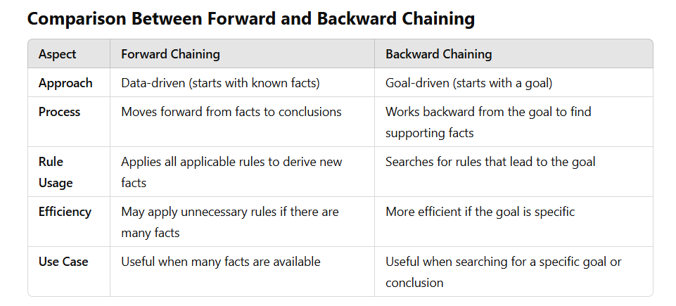

Slide 25
Knowledge Acquisition
The knowledge acquisition component allows the expert to enter their knowledge or expertise into the expert system, and to refine it later as and when required. Historically, the knowledge engineer played a major role in this process, but automated systems that allow the expert to interact directly with the system are becoming increasingly common.
Three principal stages:
1. Knowledge elicitation is the interaction between the expert and the knowledge engineer/program to elicit the expert knowledge in some systematic way.
2. The knowledge thus obtained is usually stored in some form of human friendly intermediate representation.
3. The intermediate representation of the knowledge is then compiled into an executable form (e.g. production rules) that the inference engine can process.
In practice, many iterations through these three stages are usually required.

Slide 26
Knowledge Elicitation
The knowledge elicitation process itself usually consists of several stages:
1. Find as much as possible about the problem and domain from books, manuals, etc.
2. Try to characterize the types of reasoning and problem-solving tasks that the system will be required to perform.
3. Find an expert (or set of experts) that is willing to collaborate on the project.
4. Interview the expert (usually many times during the course of building the system). Find out how they solve the problems your system will be expected

Slide 27
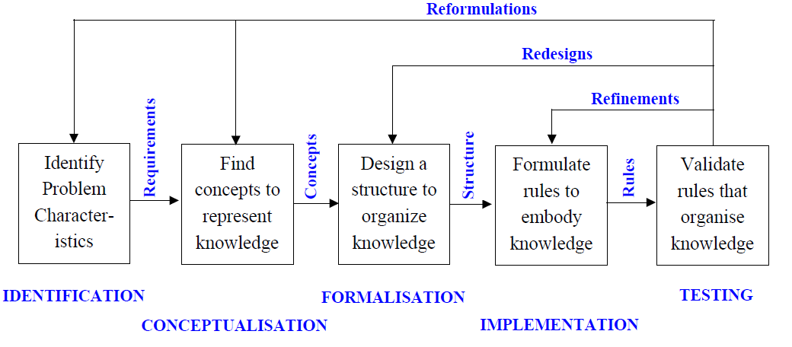
Stages of Knowledge Acquisition

Slide 28
Applications of Expert System
Medical Diagnosis
Financial and Investment Advice
Legal Advice
Agriculture and Farming
Education and Training
Manufacturing Control
Hemun Resource Recruitment
Traffic Management and more

